Slide 1
COMMON THREADS
Spring 2021
In this issue…
April is Sexual Assault Awareness Month
What is Online Sexual Abuse?
Resources for Survivors
Online Digital Consent
Raffles and Prizes on our Facebook page!
Pennsylvania Health Law Project
offers free services
Protecting Your Phone Privacy
Domestic Violence and Sexual Assault Services
24 Hour Helpline (814) 274-0240 or Toll free (877) 334-3136

Slide 2
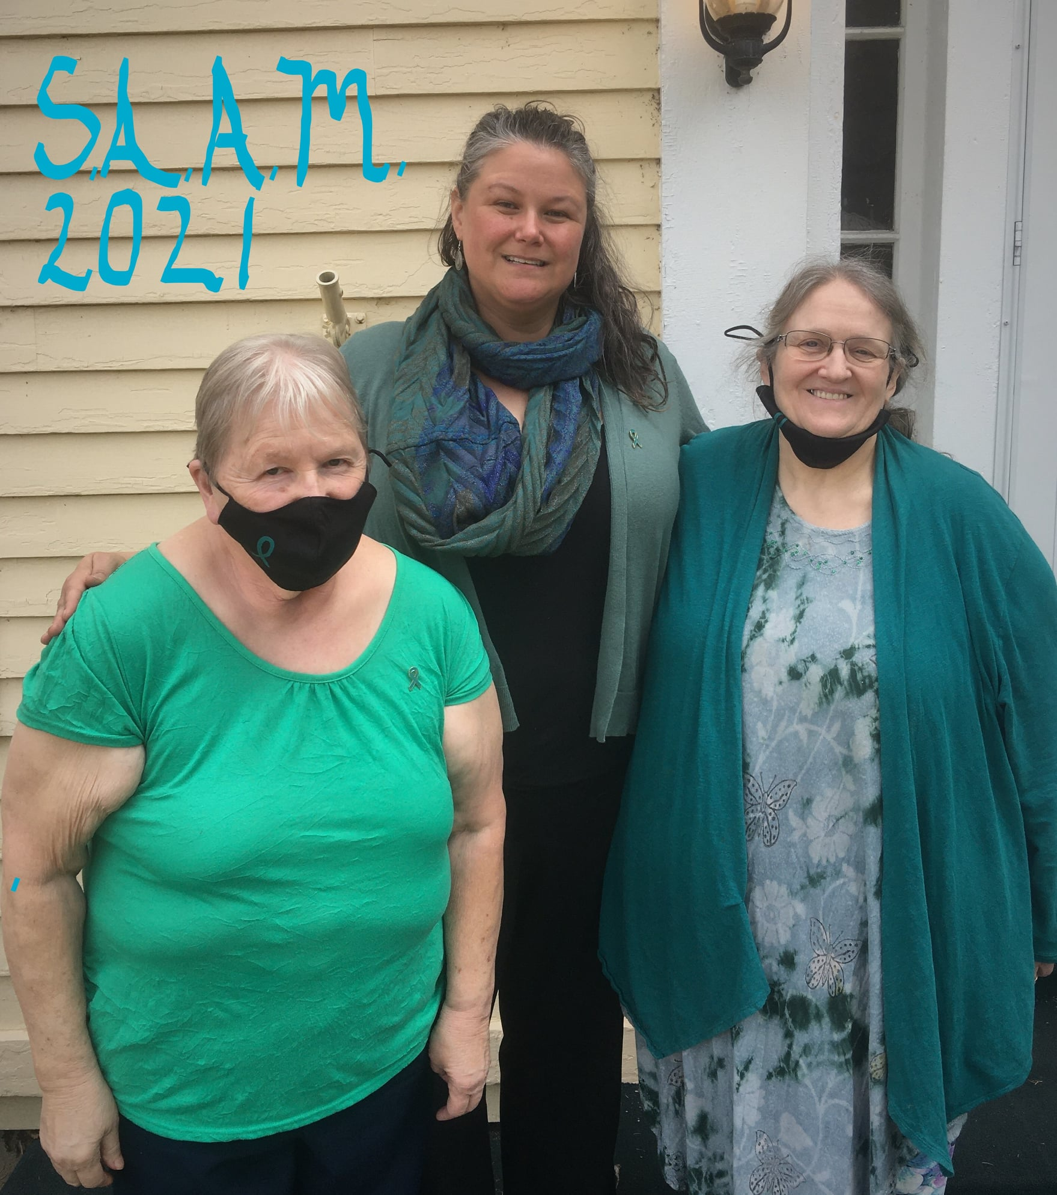
Mission Statement
The mission of A Way Out is to assist and support all victims, survivors, and families of domestic violence and sexual assault through ethical, culturally competent, and compassionate services.
We advocate for social change designed to end the cycle of abuse through dedication, community involvement and education.
Be sure to visit our FACEBOOK page!
​
​Throughout the month, A WAY OUT will be raffling off some very generous donations from local businesses and friends of A WAY OUT to raise funds to assist those affected by sexual assault in Potter County.
Keep an eye on our page for our raffle bonanza that will start
a little later in the month!
Sporting our teal outfits for Sexual Assault Awareness Month
2

Slide 3
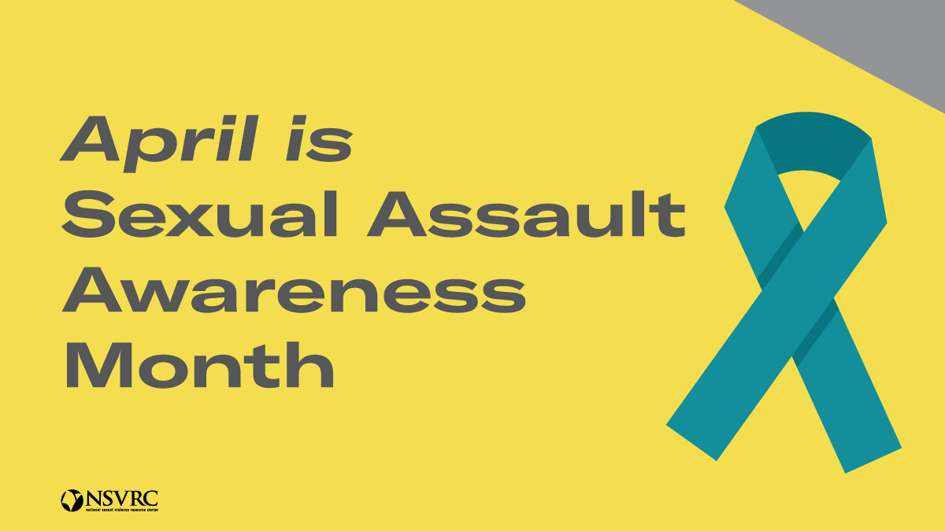
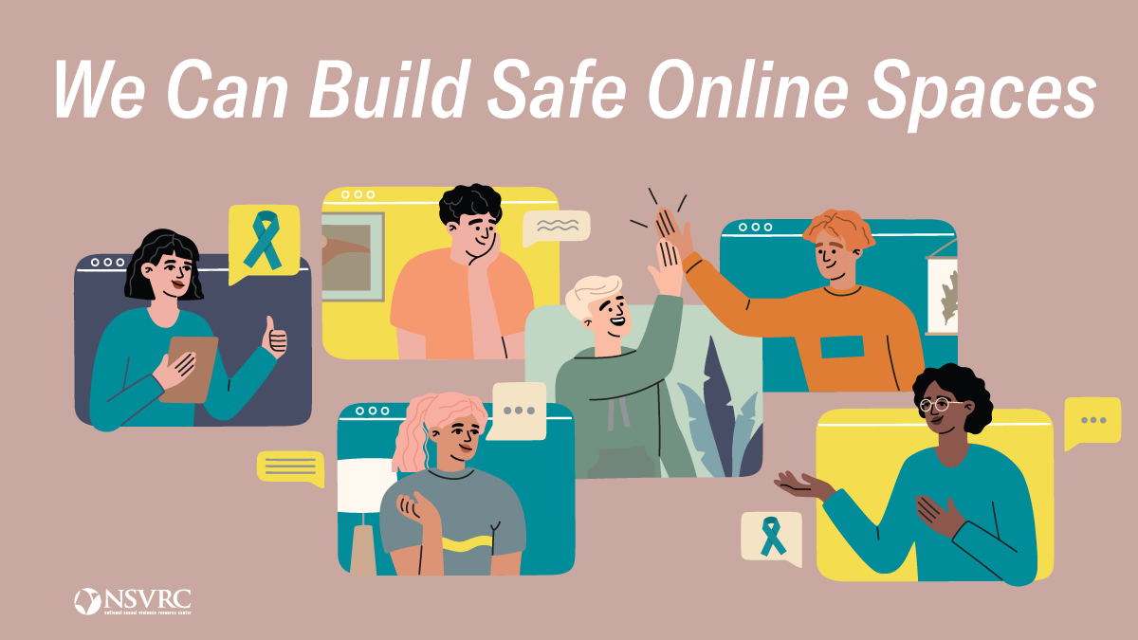
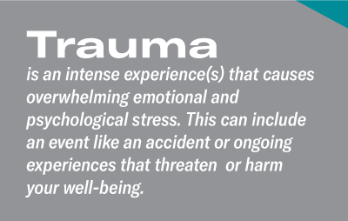
What is online sexual abuse?
Online sexual abuse can be any type of sexual
harassment, exploitation, or abuse that takes
place through screens.
Forms of online sexual harassment or abuse:
Sending someone hateful or unwelcome comments based on sex
Sending unwanted requests to partners or strangers to send nude photos or videos or livestream
sexual acts.
Performing sexual acts on webcam without the consent of everyone involved or in inappropriate settings (like during an online work meeting).
Sharing private images or videos without the consent of everyone involved, also known as revenge porn, which is illegal.
Sharing porn in spaces where everyone has not consented to view it (like in Zoom meetings or other inappropriate places, also called Zoom bombing).
Grooming children to enable their sexual abuse either online or offline.
Just because these forms of sexual abuse take place behind a screen doesn’t make their impact on the victim any less real. While some of these behaviors are crimes, particularly any that involve sexual abuse of children, others are just as harmful. Additionally, as images of abuse could be reshared and recirculated on the internet, there is an added layer of revictimization.
Experiencing trauma online
Trauma is an intense experience(s) that causes overwhelming emotional
and psychological stress. This can include an event like an accident or
ongoing experiences that threaten or harm your well-being.
Each person reacts to traumatic experiences in different ways in the immediate aftermath and long term. You may feel guilt, shame, fear, anxiety, sadness, numbness, shock, withdrawal, and alone. You may have trouble sleeping, nightmares, difficulty concentrating, and feelings of being easily startled and on edge.
Many of us may have experienced stress firsthand when we’ve received a disrespectful, de-humanizing, vulgar, or even threatening comment online. Although these experiences are unfortunately all too common in the online world, it does not make them any less harmful. Coping and healing require acknowledging the impact of online sexual abuse without dismissiveness, judgement, or shame.
SOURCE: https://www.nsvrc.org/saam/2021/about/onlineabuseandtrauma
3

Slide 4
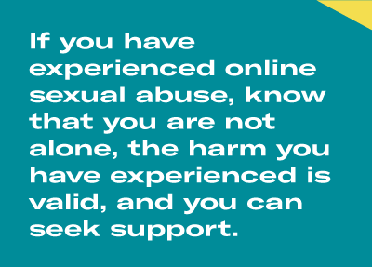
Trauma-informed online spaces
When building communities — whether online or in-person —
it’s important to remember that many people you’re interacting with
have probably experienced some form of trauma.
Being trauma-informed means taking into consideration a person’s
experience of trauma and their reactions to it.
We can create trauma-informed online spaces by:
Giving participants choices about how to engage. For example, not requiring everyone to turn their video cameras on.
Make it clear if and how information shared in the space will be shared outside the space. One of your community agreements could be around not repeating others’ personal stories that are shared within the space so that participants feel comfortable.
Connecting participants to the support they may need. Let people know where they can go for help if something in the online community is triggering.
Online sexual abuse and resources for survivors
Just like with abuse that takes place physically, online sexual harassment and abuse can be traumatic. Online sexual harassment and abuse can threaten your sense of safety and overwhelm the nervous system in the same ways harm, physical threats, and in-person events are experienced.
Finding support online
Online sexual abuse can be traumatic, which left untreated can lead to PTSD and other long-term health issues. If you have experienced online sexual abuse, know that you are not alone, the harm you have experienced is valid, and you can seek support.
Online resources for survivors
Your local sexual assault resource center: These community centers can help survivors of abuse, no matter when the abuse occurred and no matter if a report was made to police. Local sexual assault advocates will let you know what services are available to support survivors — whether virtually or in-person — in your community. (Go to our website at www.myawayout.org and click on the SURVIVOR ONLINE SUPPORT tab to see a variety of online support groups).
RAINN (Rape, Abuse & Incest National Network): RAINN operates the National Sexual Assault Hotline where their volunteers offer support 24/7 to survivors and their loved ones. Whether you’re looking for support, advice, or a referral, you can contact RAINN at 800-656-HOPE or chat online with a trained support specialist.
Message boards, forums, and groups: Survivors are connecting online in communities such as subreddits where they are sharing their stories with others. While a less formal form of support, these online spaces provide a platform where survivors can share experiences and support one another.
SOURCE: https://www.nsvrc.org/saam/2021/about/onlineabuseandtrauma

Slide 5
Creating a pathway for respectful online spaces with consent
From apps to online dating websites, there are many ways people are
connecting online. Although you aren’t talking face-to-face with
someone, consent still needs to be communicated along the way. You should always consider how your actions might make another person feel and ask questions if you don’t know.
Unlike in-person interactions, there may not be body language cues, like eye contact, that can indicate how someone is really feeling. So when we communicate online, it’s important to develop new ways to recognize others’ boundaries and give them the space to recognize our boundaries as well. If we shift from making assumptions to clearly communicating our boundaries and asking questions when we’re not sure, we can create a pathway to more respectful online spaces.
We show respect for ourselves and for others in everyday ways when we practice consent. Consent sets a baseline for using our actions and words to demonstrate the value of others through respecting their limits. Consent gives us a framework for how to communicate boundaries and understand how our choices impact others.
Consent in online contexts and situations
When it comes to sexual activities that take place through screens, such as sexting, sending nude photos, or connecting for in-person physical sex, digital consent is a baseline for moving forward.
Digital consent is a way to refer to sexual consent that happens
through screens. Just like in real-life sexual encounters, consent should
be an on-going conversation when communicating digitally. Although
you aren’t talking face-to-face, you should always consider how your actions might make another person feel and ask questions if you don’t know.
We can practice digital consent by:
Asking permission before sending explicit messages or texts
Respecting the decisions of others once you ask. It’s never okay to coerce or pressure someone to send photos or record sexual acts. If someone says no after you ask for digital consent, respect their choice and move on.
Understanding that everyone has boundaries around meeting up in real life. If you’ve met online or on an app, make sure you both agree on the next steps and feel safe and comfortable with meeting up in person. Regardless of what others expect, everyone has the right to decide what is best for them and to act on those values.
Asking each time. Getting digital consent is important every time — even if your partner agreed to something before, they are not obligated to agree to do it again.
Consent isn’t only important when it comes to sex — there are everyday ways that we negotiate our needs with the needs of others.
SOURCE: https://www.nsvrc.org/saam/2021/preventionresources/digitalconsentboundaries

Slide 8
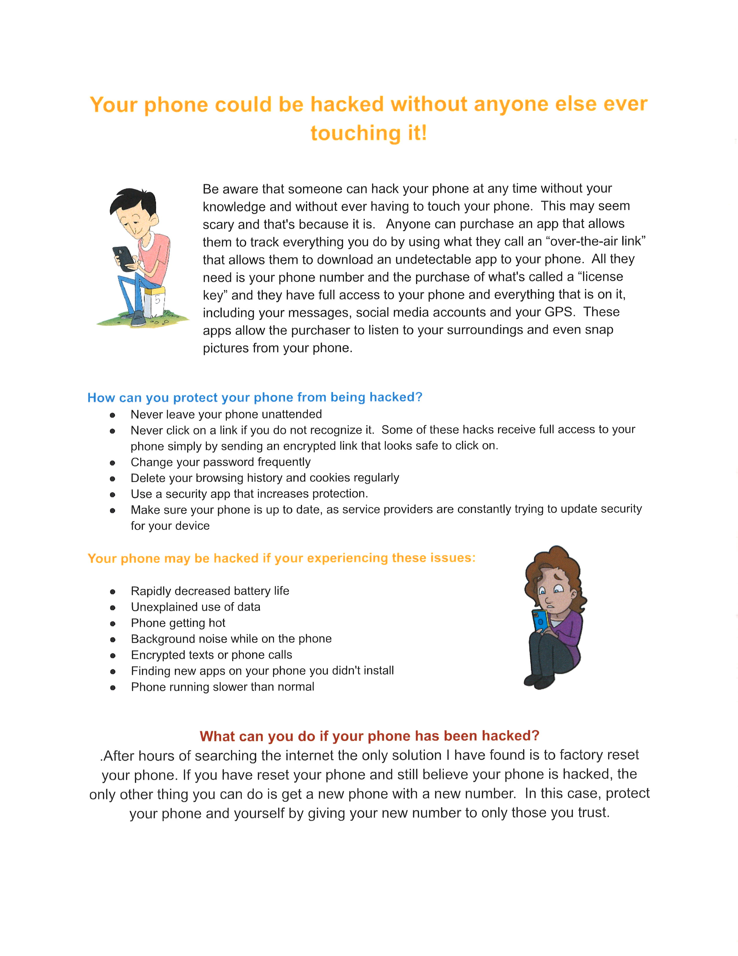
Protecting Your Phone Privacy
8

Slide 9
FOOD BANKS:
Coudersport / Alliance Church, – 7 Alliance Ave, every Tues & Thurs, 10:30am – 1:30pm, 814-274-8661
Austin / Austin Fire Hall, 42 W Main St, every 3rd Tues, Check Austin Food Pantry FB page for time(s), 814-647-8562 Roulette / Firehall, Times TBD monthly, 814-544-7365 Ulysses / Zion Christian Assembly, 4th Thursday, 10-11am. 814-848-7407 Galeton / St. Paul Lutheran Church, 4th Friday, 10-11am. 814-435-2471 Shinglehouse / Methodist Church, 4th Saturday, 9-10am. 814-698-2144
AA MEETINGS: TUESDAY 8pm @ Christ Episcopal Church, Coudersport WEDNESDAY Noon @ St. Paul’s Lutheran Church, Coudersport and 8 pm @ St. Eulalia’s Catholic Church, Coudersport THURSDAY AL-ANON, 6-7pm @ First Presbyterian Church, Coudersport AA, 7pm @ Park United Methodist Church, Coudersport FRIDAY 8pm @ St. Augustine Rectory, Austin and Noon @ First Presbyterian Church, Coudersport SATURDAY 8pm @ Galeton Presbyterian Church

Slide 10
Be sure to LIKE us on Facebook and watch for upcoming events and fundraisers!
Did you know… we manage the FREE Child Car Safety Seat Program?
Just call and let us know the age/weight of the
child or children that require car seats and we
can schedule a time for you to view the 30
minute safety video and pick up your car seat(s).
Closed Office Holidays for 2021:
May 31st – Memorial Day
July 5th – Independence Day
September 6th – Labor Day
November 11th – Veterans Day
November 26th and 27th – Thanksgiving
December 24th / 27th – Christmas
December 31st 2021 / January 3rd 2022 – New Year’s
If you need assistance outside of regular business hours or on a holiday, you can call the 24 hour Helpline at 814-274-0240 or toll free at 1-877-334-3136.

